Slide 1
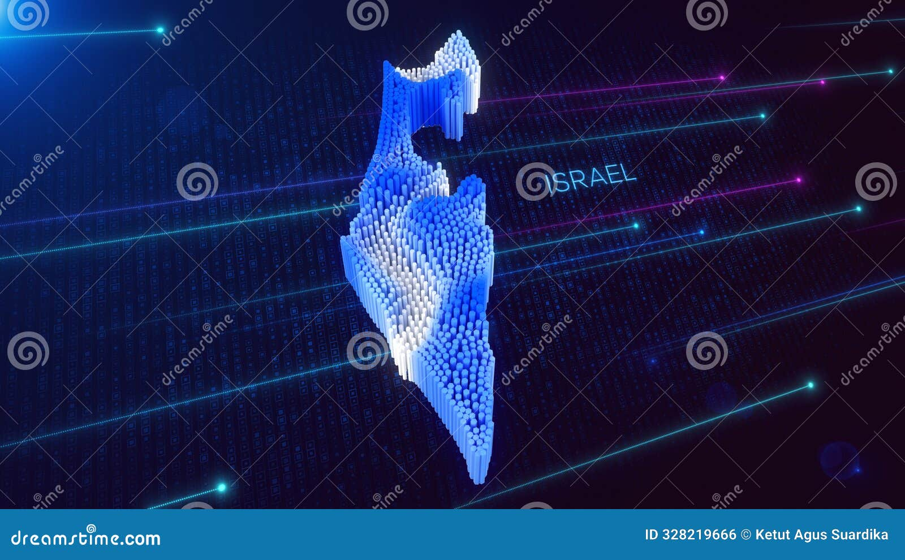
TechMap Israel
Analyzing the Correlation Between High-Tech Companies and Urban Population Distribution in Israel
Niv Ozer Guy Kopel Nitay Hen Bar Nahmuka

Slide 2
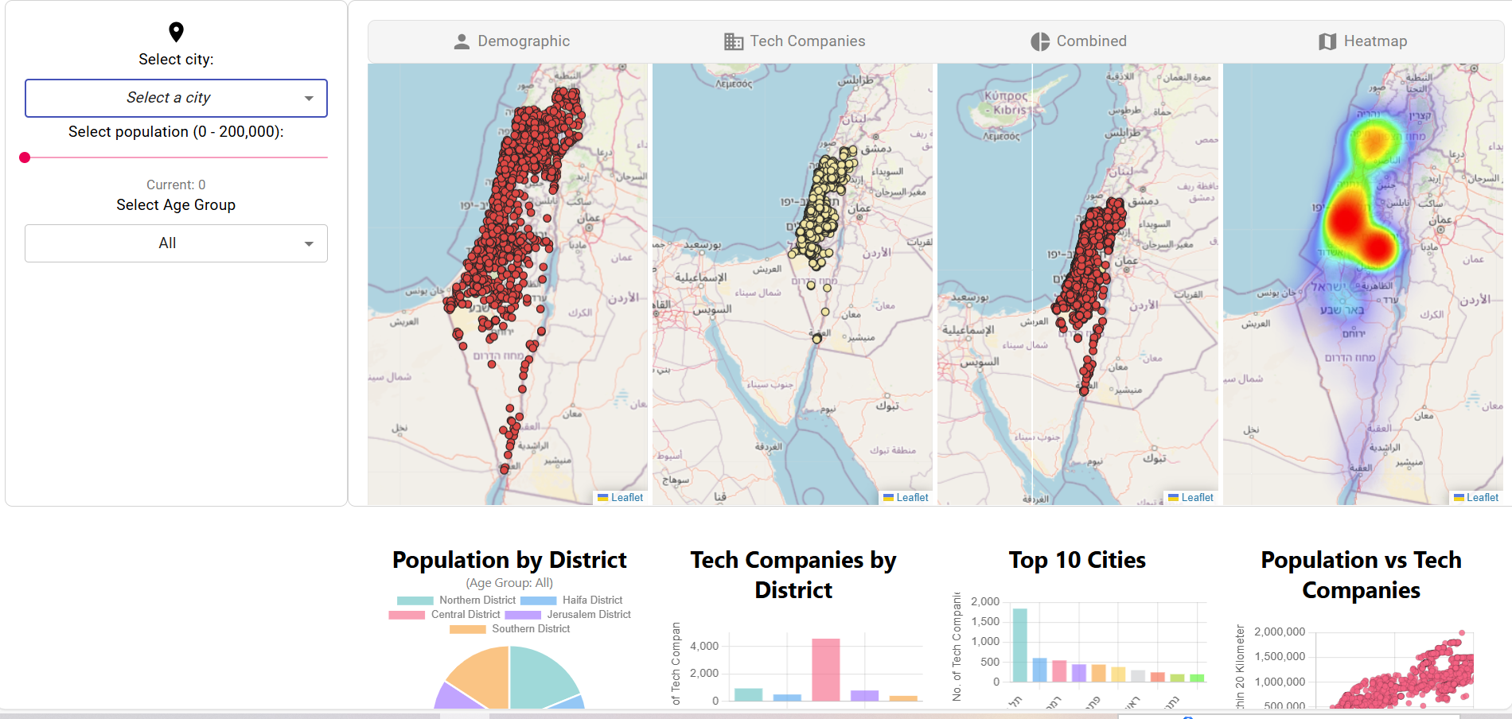
Project
Overview
Israel, known as the 'Startup Nation’, has a rapidly growing high-tech sector concentrated in specific urban areas. This project aims to explore the relationship between tech company distribution and urban population density across Israel. Understanding this correlation is essential for informed urban planning and supporting economic development.

Slide 3
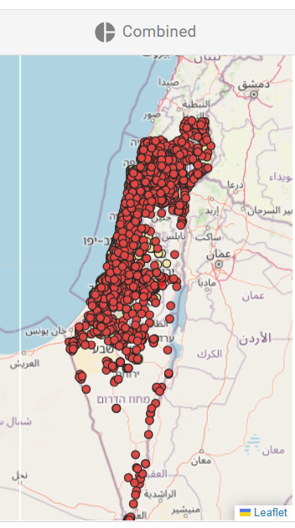
Goals & Objectives
Main Goal: To visualize and analyze the correlation between high-tech company presence and population distribution in Israel's urban centers.
Objectives: 1. Identify regions with high concentrations of tech companies. 2. Observe how tech presence relates to population density and growth trends.
Target Audience: This tool is designed for urban planners, policymakers, tech companies, investors, and residents interested in data-driven insights.

Slide 4

Technical Stack
The project is built with a combination of web development technologies and geographic information systems.
Frontend: The user interface is designed with JavaScript and integrates QGIS for mapping.
Backend: "Data is stored in MongoDB to manage population and tech company data efficiently."
Mapping & Visualization: "Leaflet library powers the interactive maps, while D3.js renders dynamic data visualizations."

Slide 5
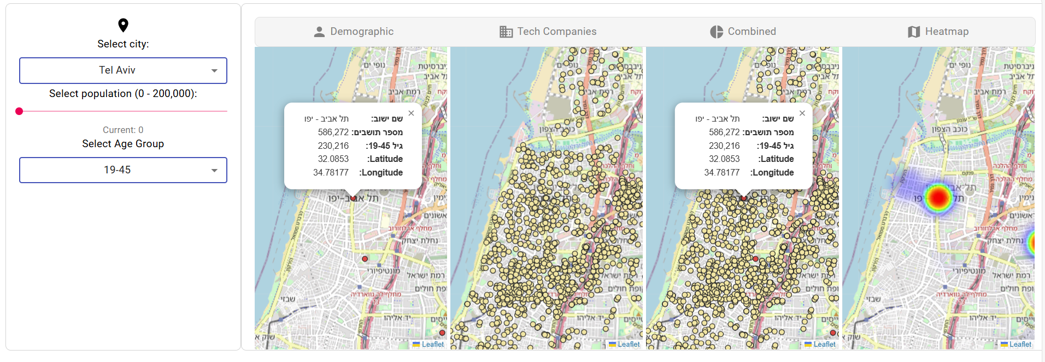
Interactive Features
Users can filter the data by city, population range, and age group to tailor the insights to their specific needs.
The application offers multiple map views to explore demographic distribution, tech company locations, and combined data.

Slide 6
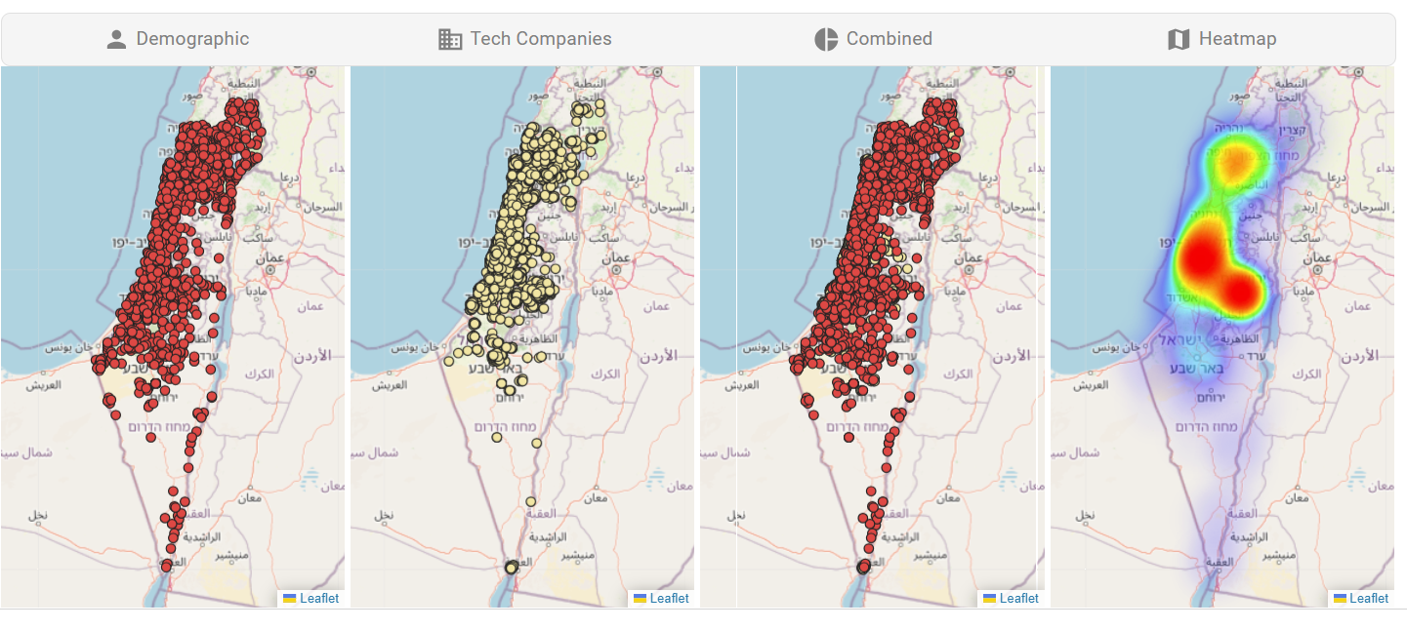
Multiple Map Views
Demographic Map: Displays population distribution across different regions in Israel.
Tech Companies Map: "Shows where tech companies are concentrated.“
Combined Map: "Displays tech companies and population data together for comparison.“
Heatmap: "Highlights areas with the highest density of tech companies and population."

Slide 7
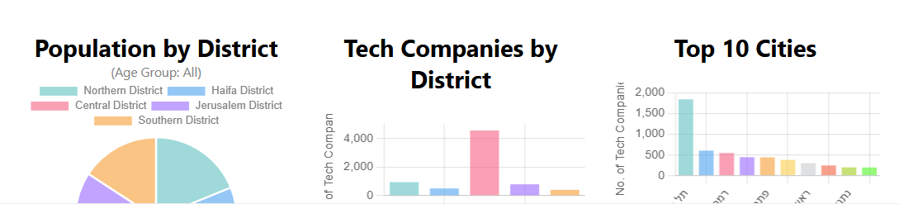
Data Visualizations
The application includes various graphs to illustrate the distribution of population and tech companies across districts and cities.
Population by District: Highlights population spread across different regions.
Tech Companies by District: Shows which districts have the highest concentration of tech companies.
Top 10 Cities: Compares tech presence among the ten most populated cities.

Slide 8
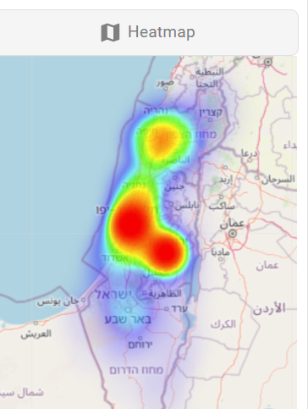
Conclusion and Key Takeaways
This project provides a dynamic tool for visualizing and understanding the interplay between tech sector growth and urban population distribution in Israel. It offers valuable insights for stakeholders, helping them make data-driven decisions to support sustainable development. By expanding on this foundation, we can create even more impactful tools for urban planning and economic analysis

